Slide 1

A Python-based platformer game with underlying story based on stages of grief
Presented by group 11, bs CoE 1-3
Astibe, Detona, Rebulanan, Salamat
JUMP TO…

Slide 2
Jump to…
Back
Introduction
objective
Start
Demo
Assets
Raw Code
Code
Level Design
Story Images
Documentation
end

Slide 3
introduction
Mental health awareness is slowly being an important topic among people nowadays. But there is still a certain number of individuals that still hide what they are going through. There is a known stages where an individual that experienced a traumatic or problematic experience known as the stages of grief. One can go through these stages without having someone to be with and help them. Consequences might happen to these individuals. A raised awareness towards mental health and its associated problems may help reduce the number of people facing the consequences of experiencing them.
JUMP TO…

Slide 4
Objectives
The team wants to produce a python based game with underlying story based on stages of grief. It also aims to raise awareness and help people undergoing the stages of grief.
JUMP TO…

Slide 5
Program demo
Gameplay and Demonstration
JUMP TO…

Slide 6
Program demo
Pre-recorded Video
Run code or View Code
JUMP TO…

Slide 7
Level Design
SKIP
JUMP TO…

Slide 8
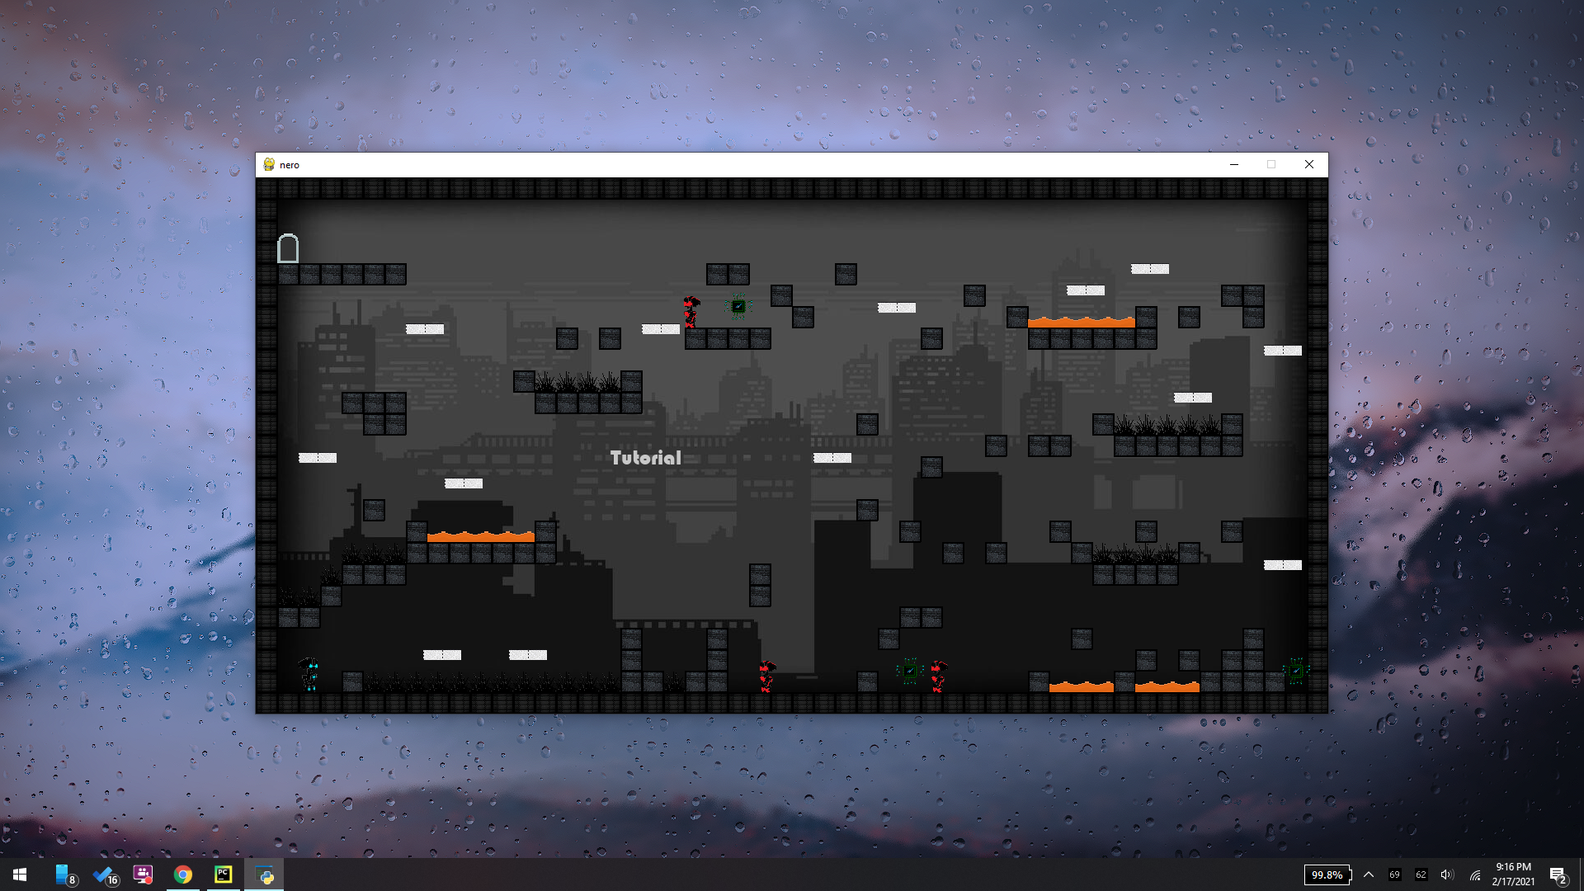

Slide 9
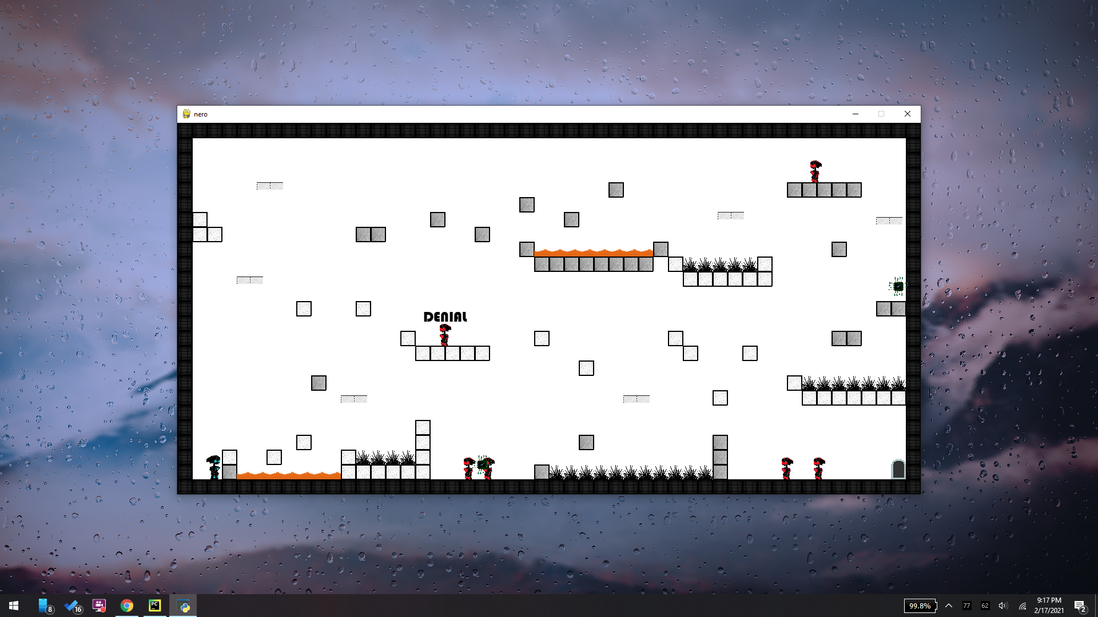

Slide 10
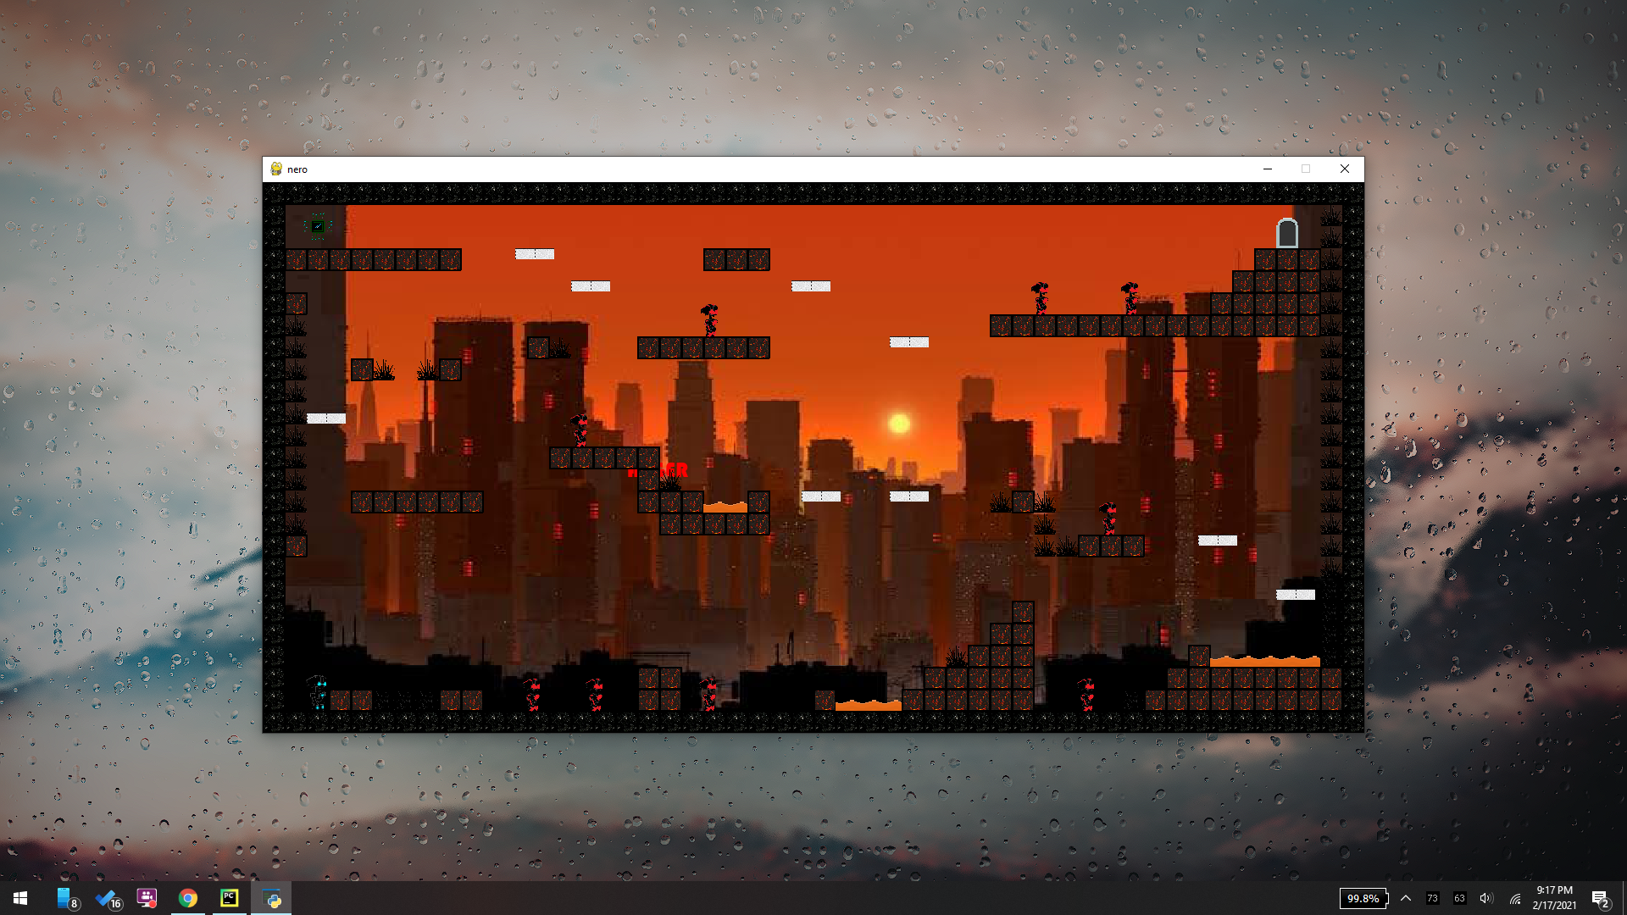

Slide 11
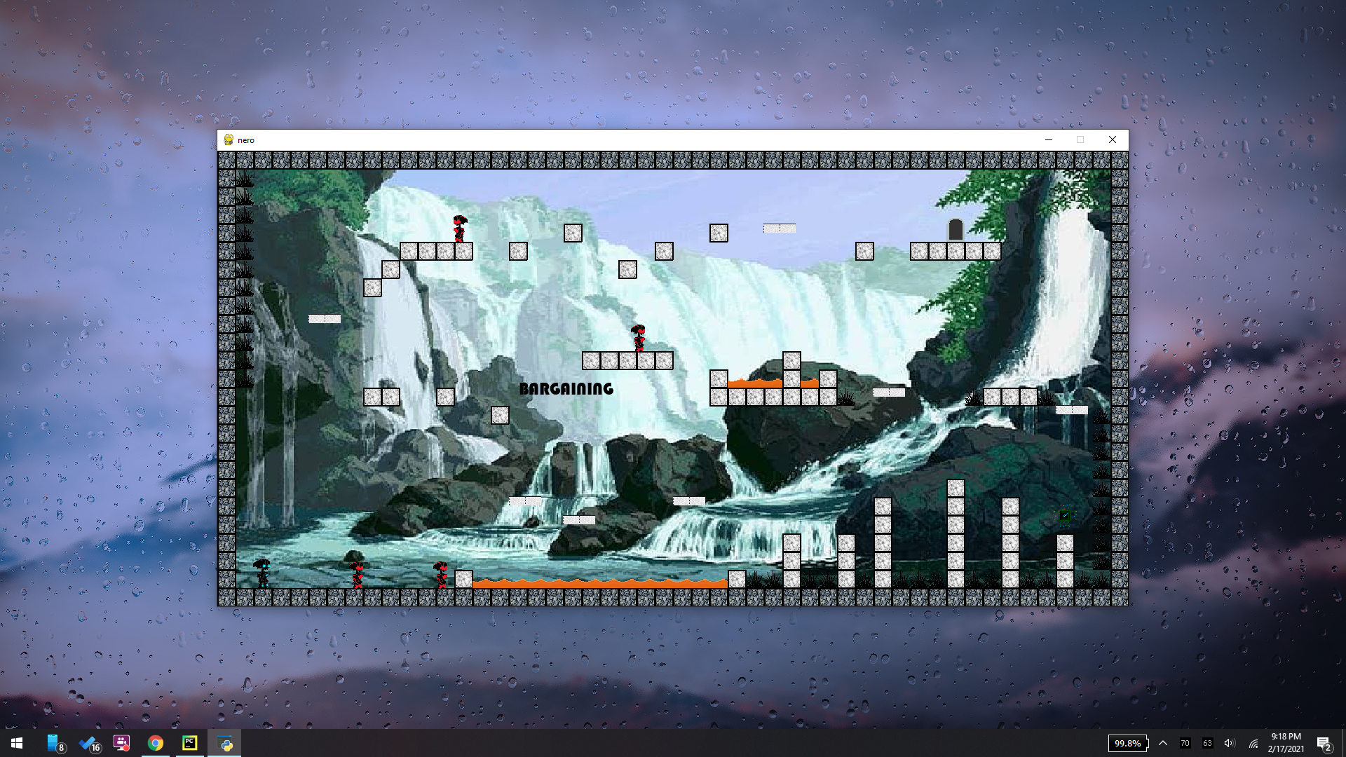

Slide 12
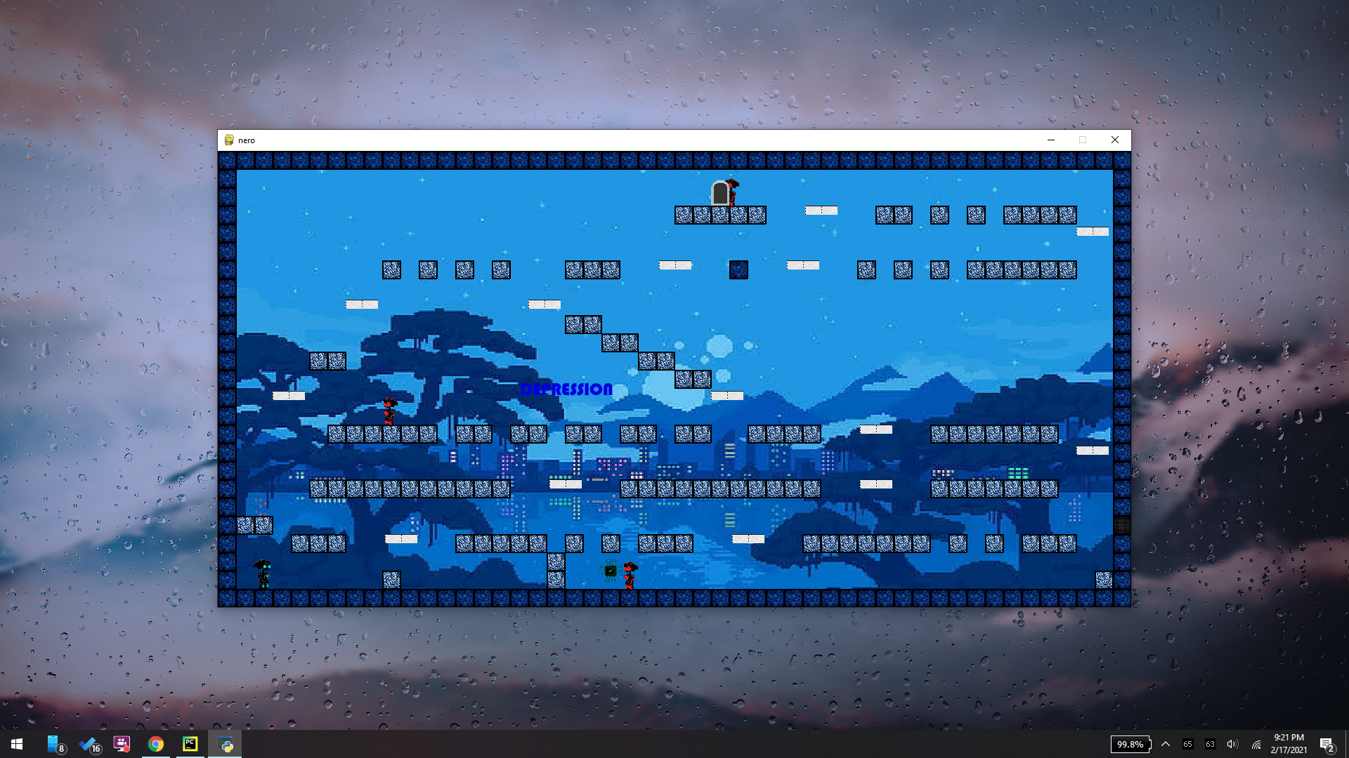

Slide 13
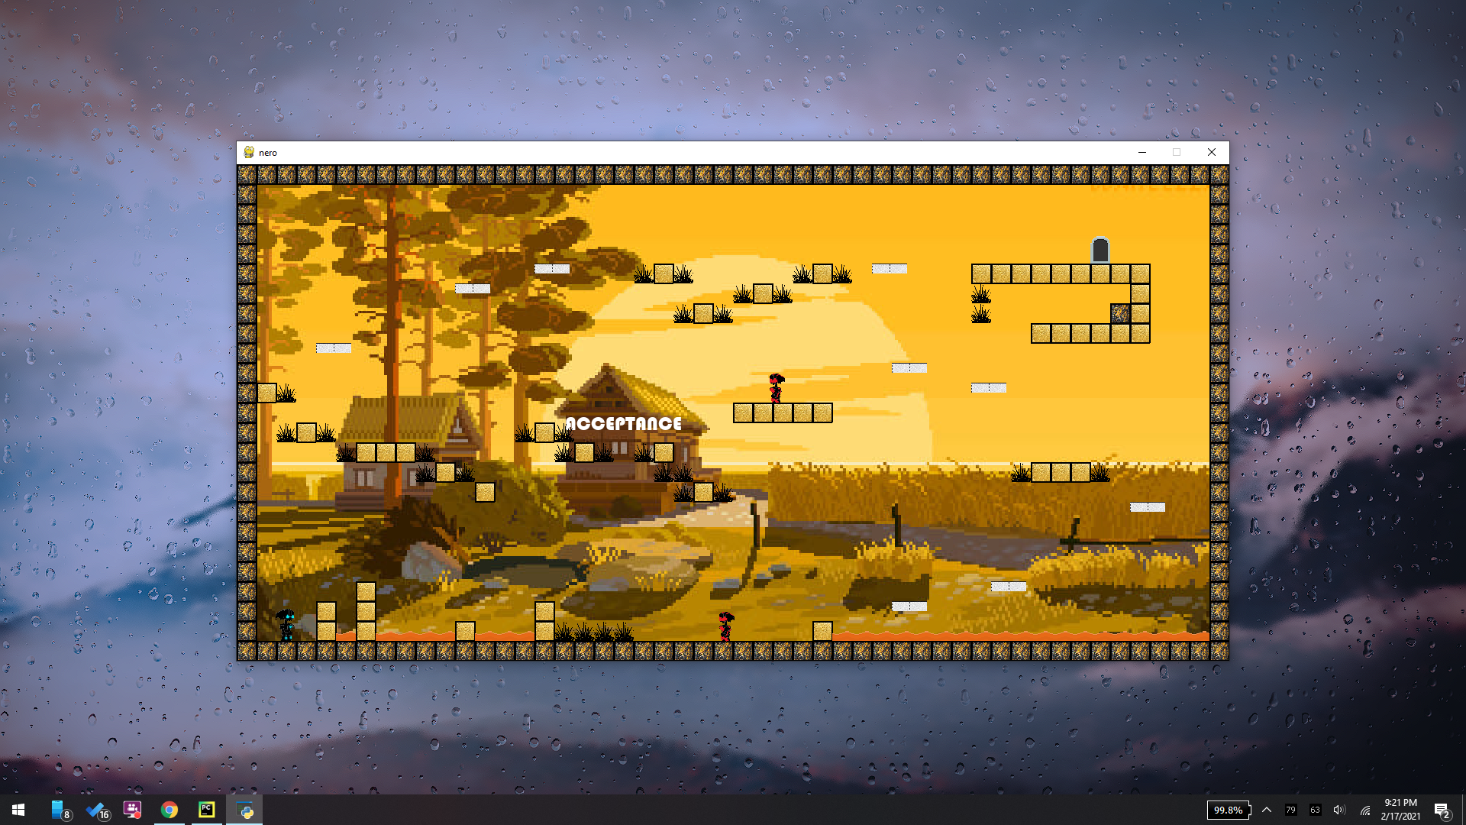

Slide 14
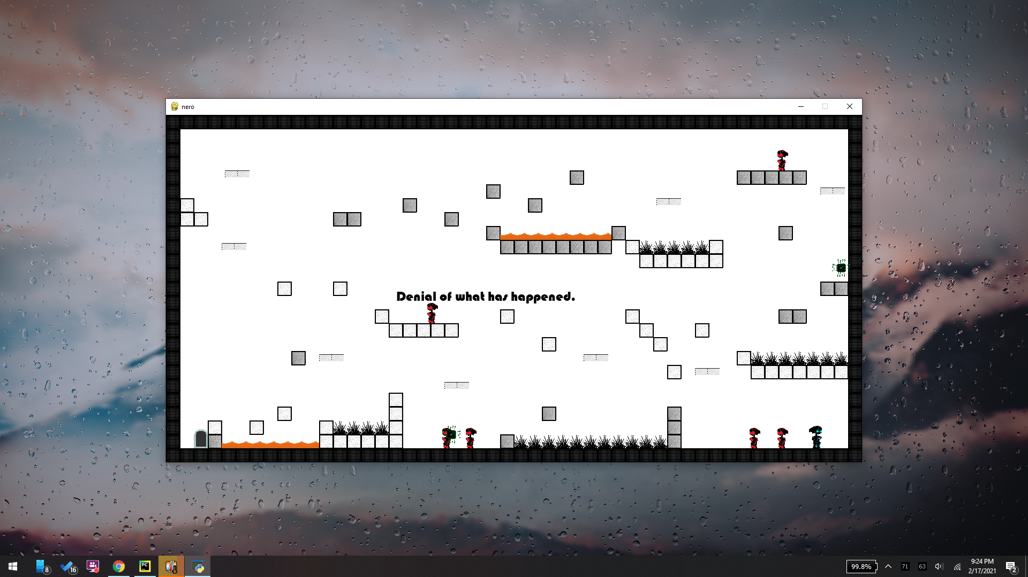

Slide 15
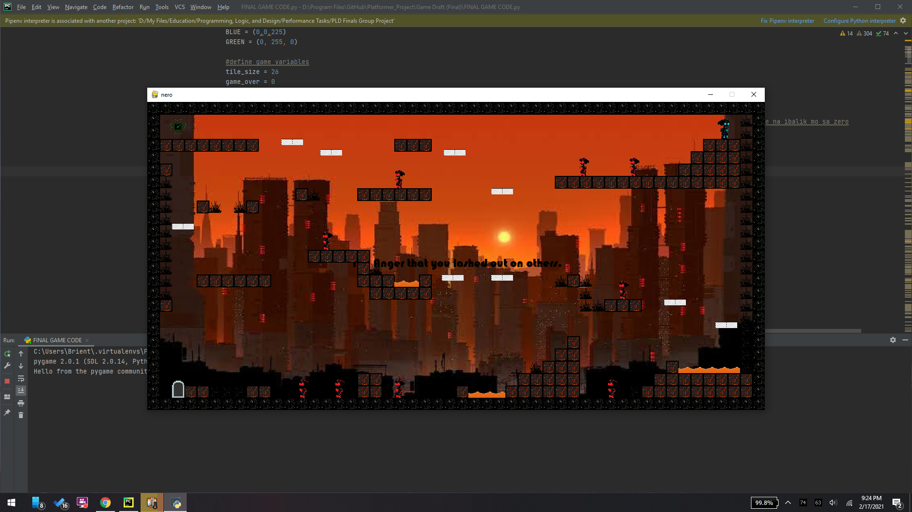

Slide 16
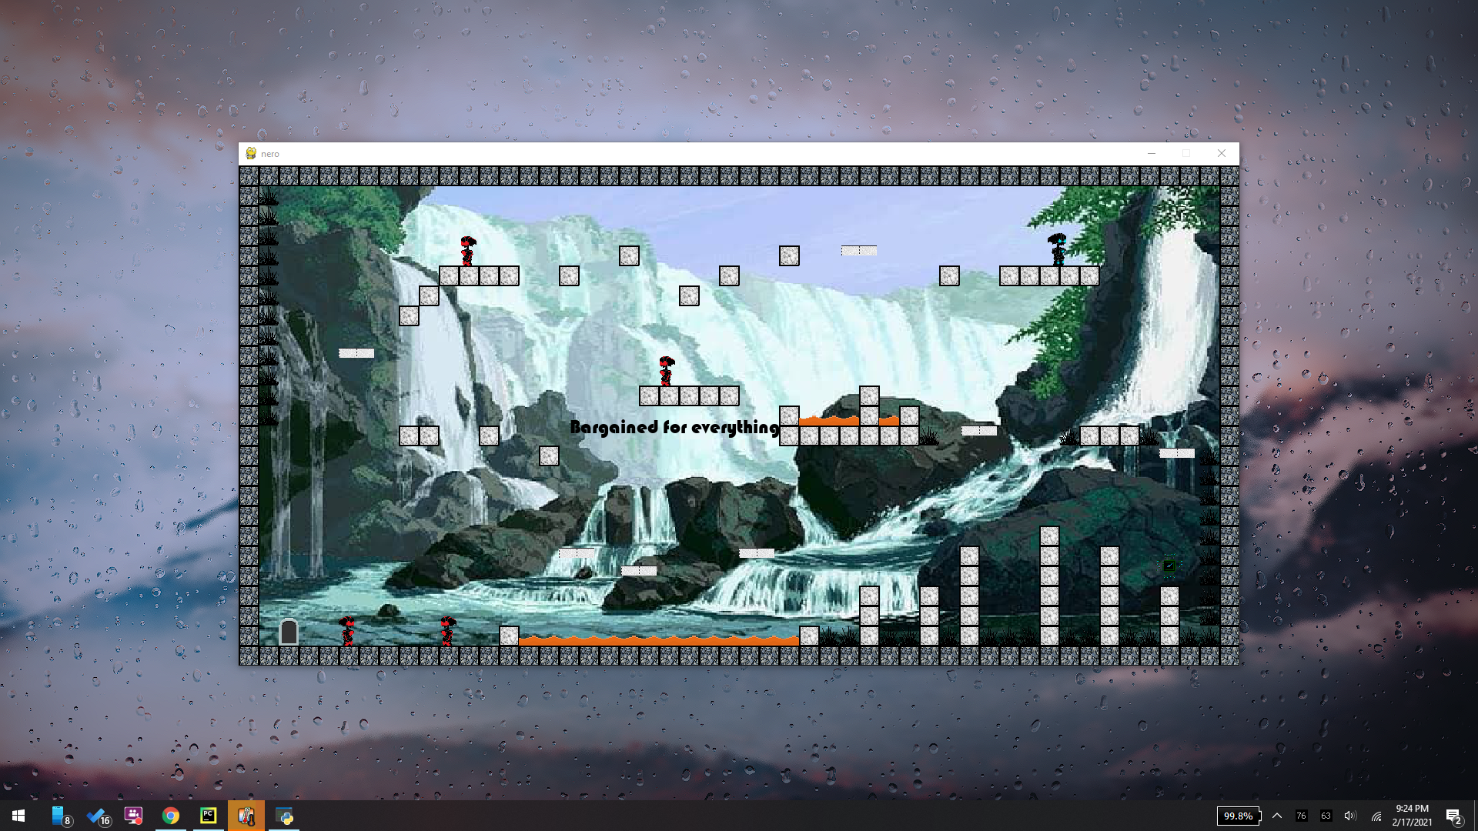

Slide 17
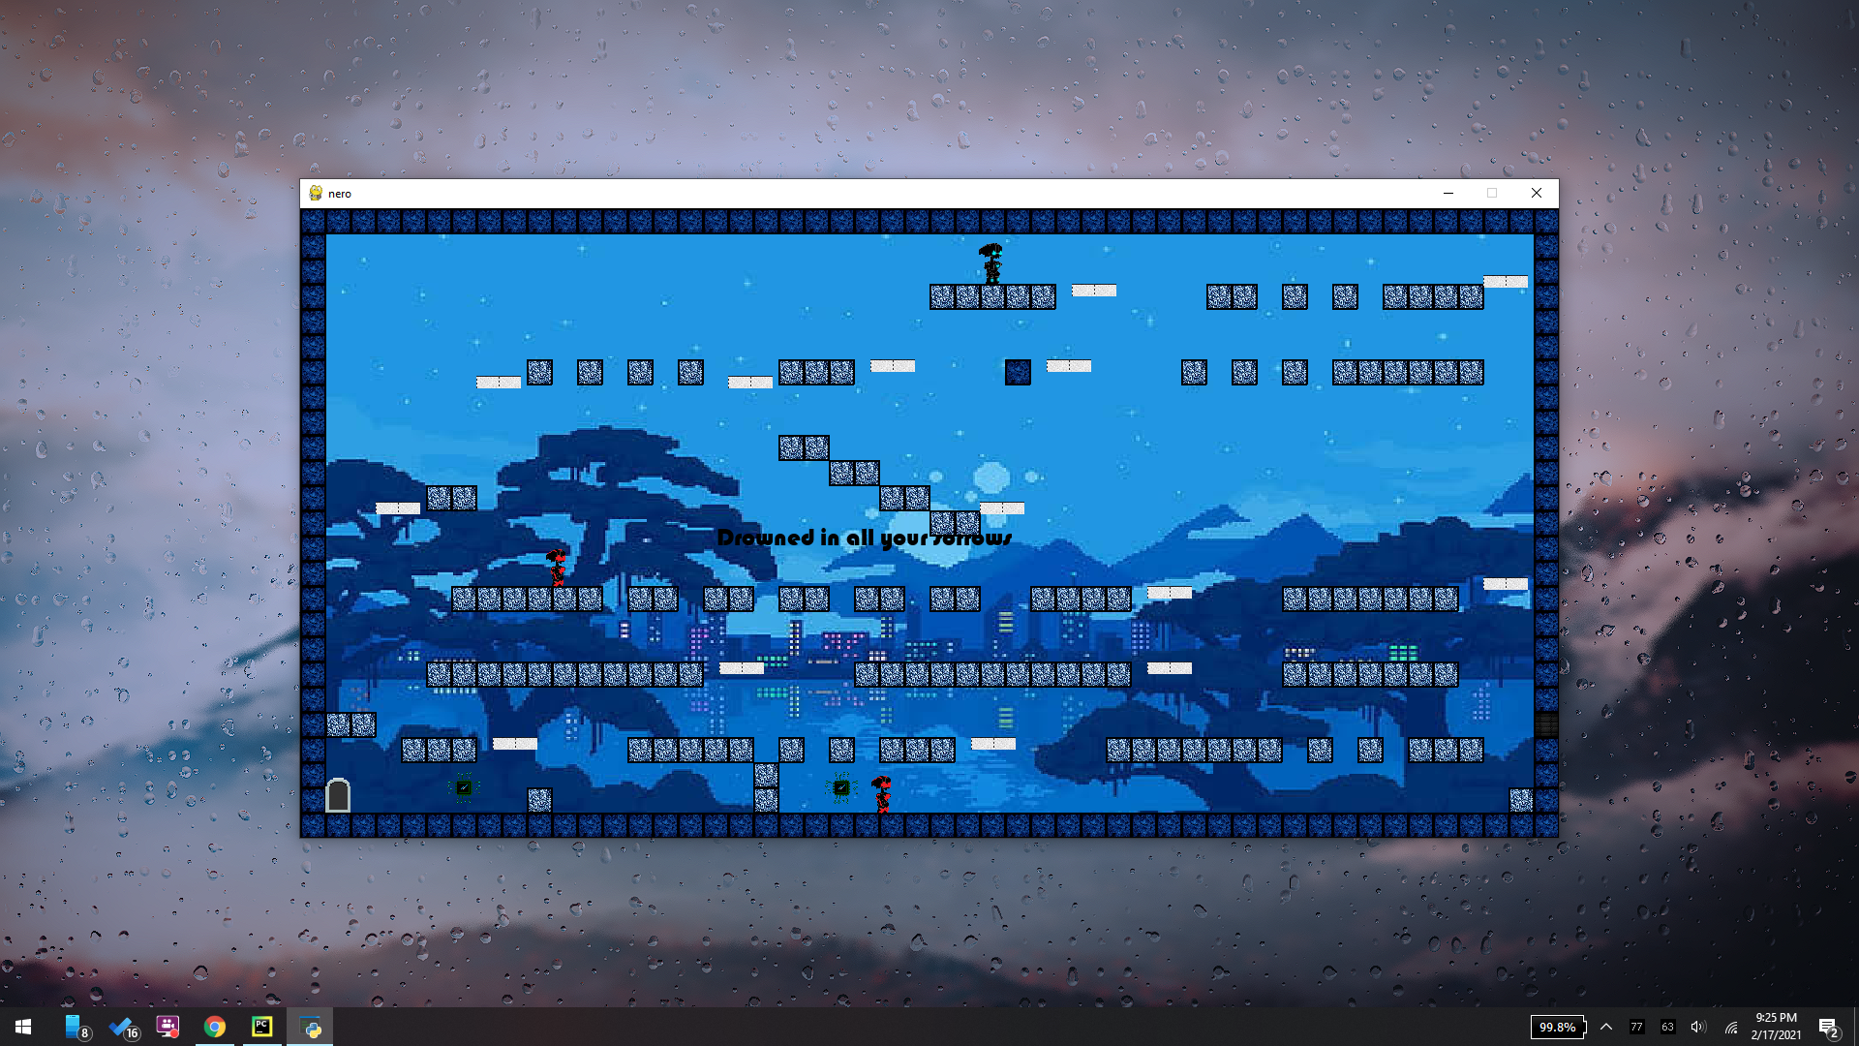

Slide 18
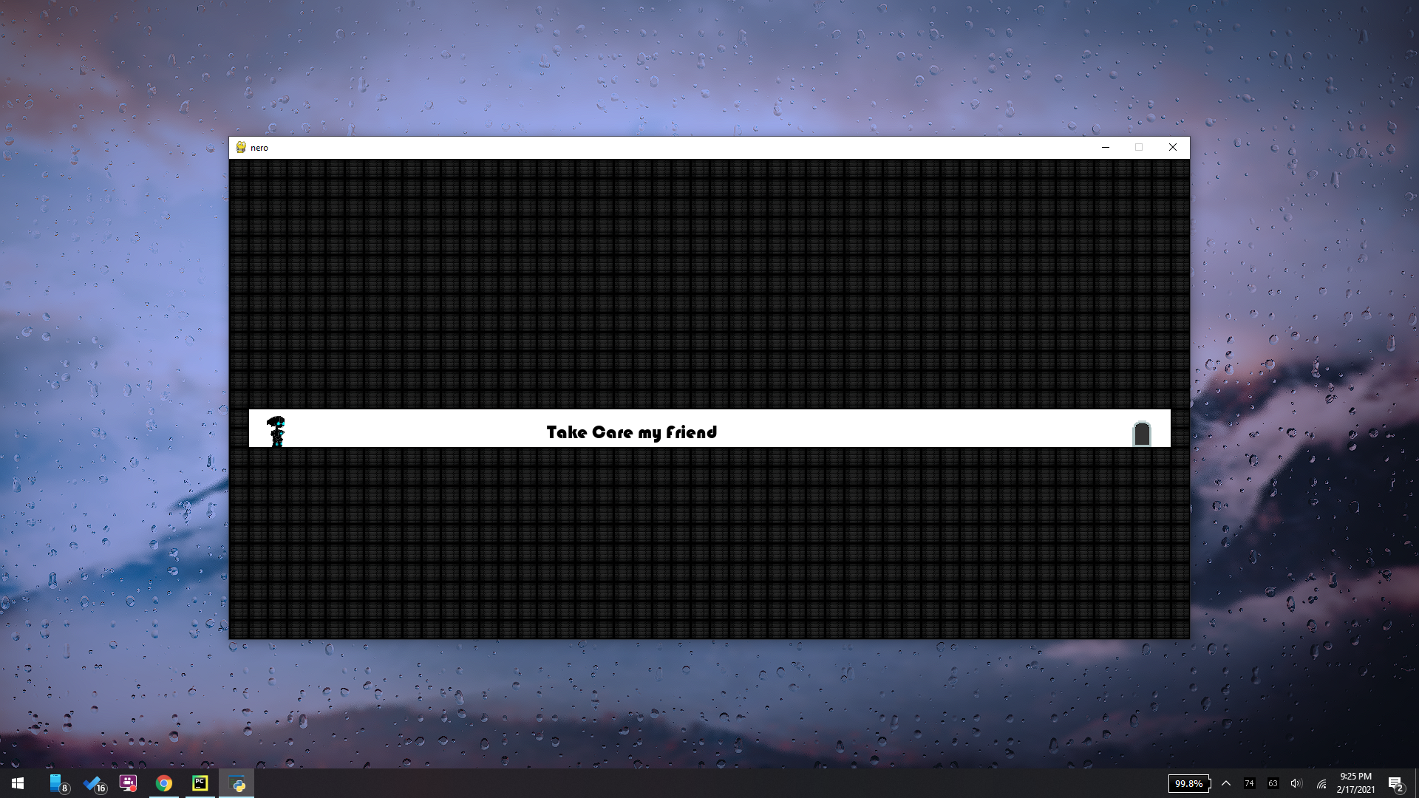

Slide 19
Quotes and story line
SKIP
JUMP TO…

Slide 20




Slide 21




Slide 22

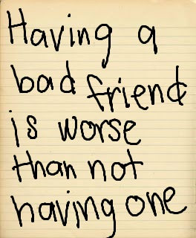


Slide 23


Slide 24
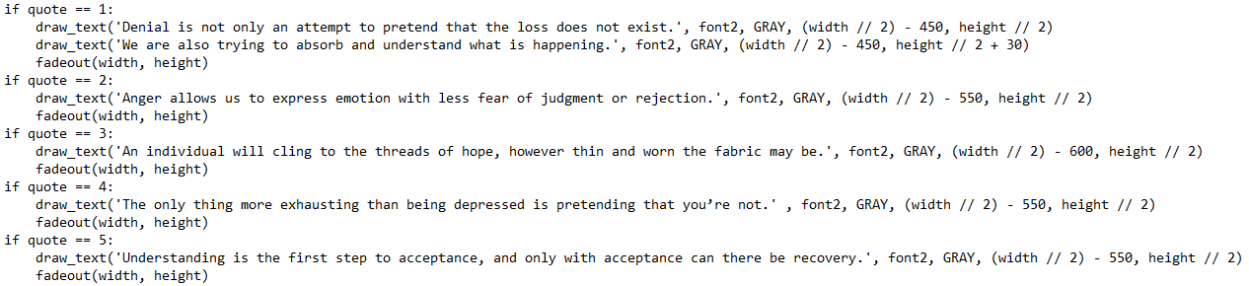

Slide 25
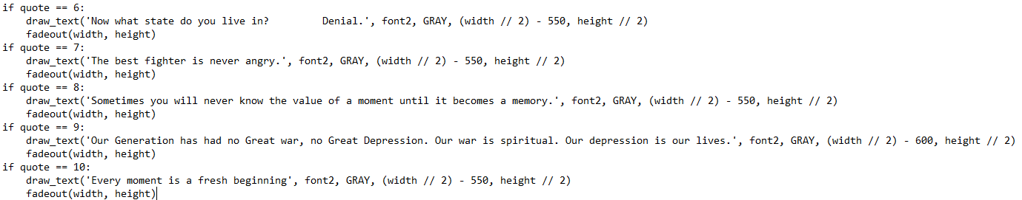

Slide 26
Program code
SKIP
JUMP TO…

Slide 27
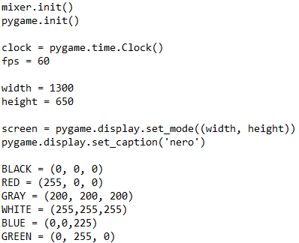
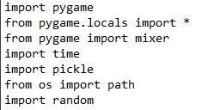
JUMP TO…

Slide 28
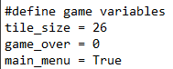
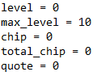
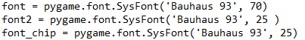
JUMP TO…

Slide 29
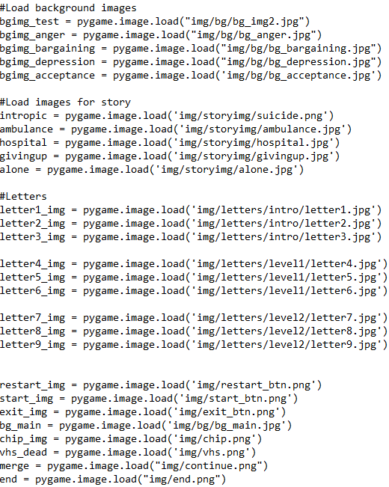
JUMP TO…

Slide 30
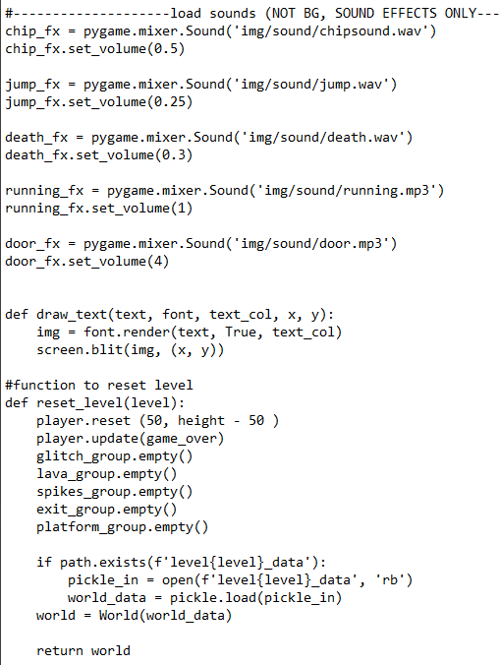
JUMP TO…

Slide 31
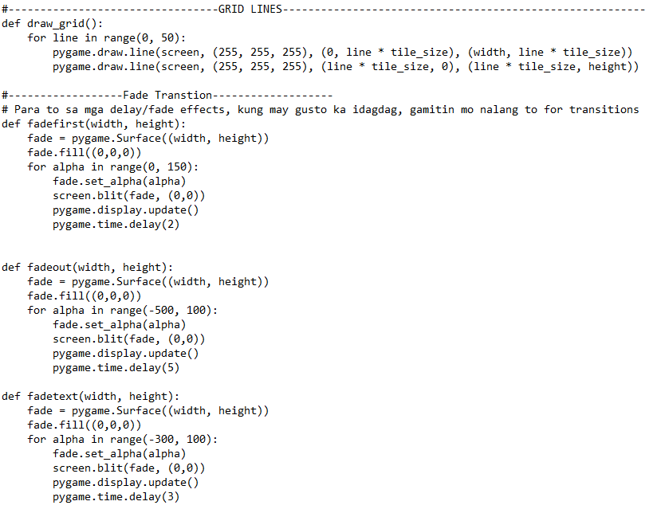
JUMP TO…

Slide 32
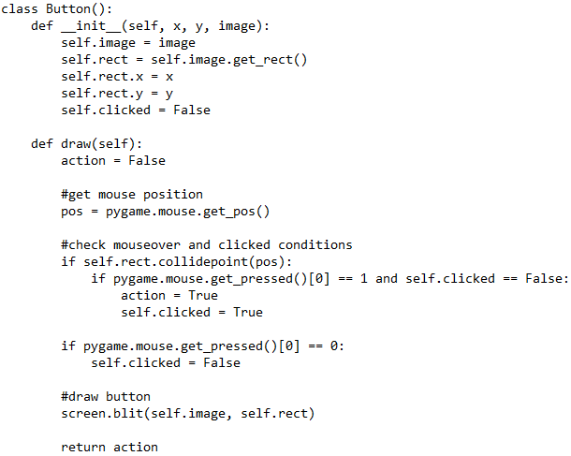
JUMP TO…

Slide 33
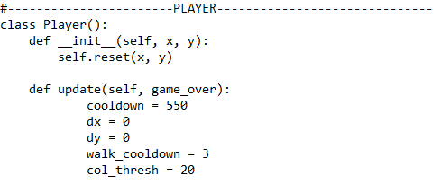
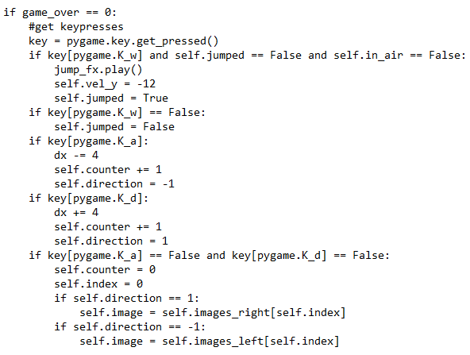
JUMP TO…

Slide 34
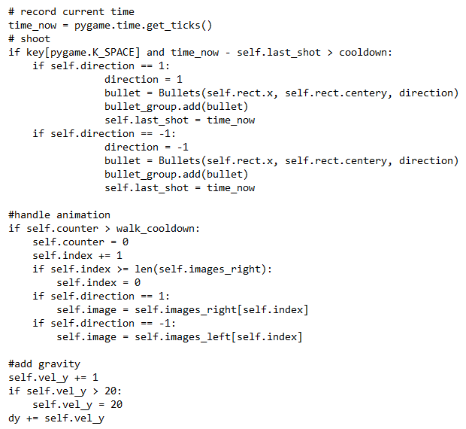
JUMP TO…

Slide 35
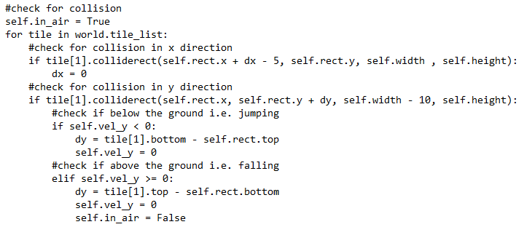
JUMP TO…

Slide 36
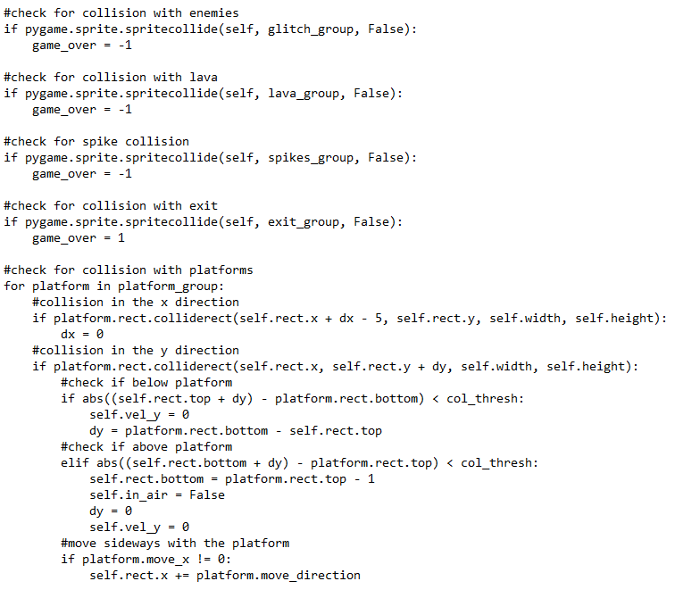
JUMP TO…

Slide 37
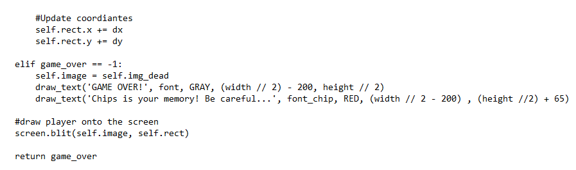
JUMP TO…

Slide 38
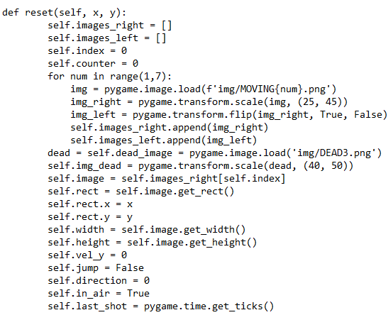
JUMP TO…

Slide 39
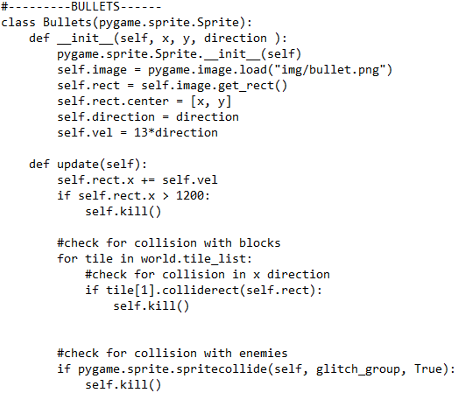
JUMP TO…

Slide 40
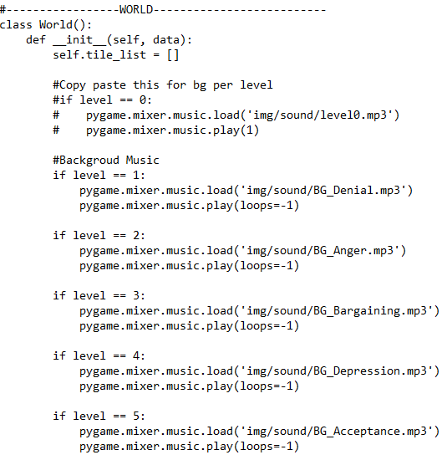
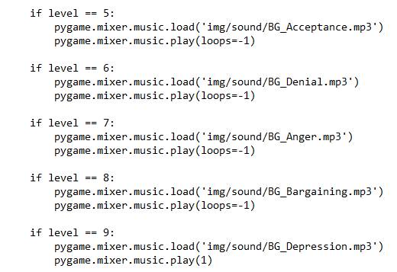
JUMP TO…

Slide 41
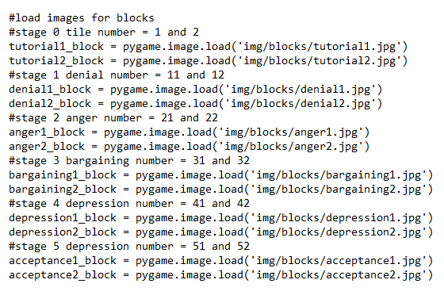
JUMP TO…

Slide 42
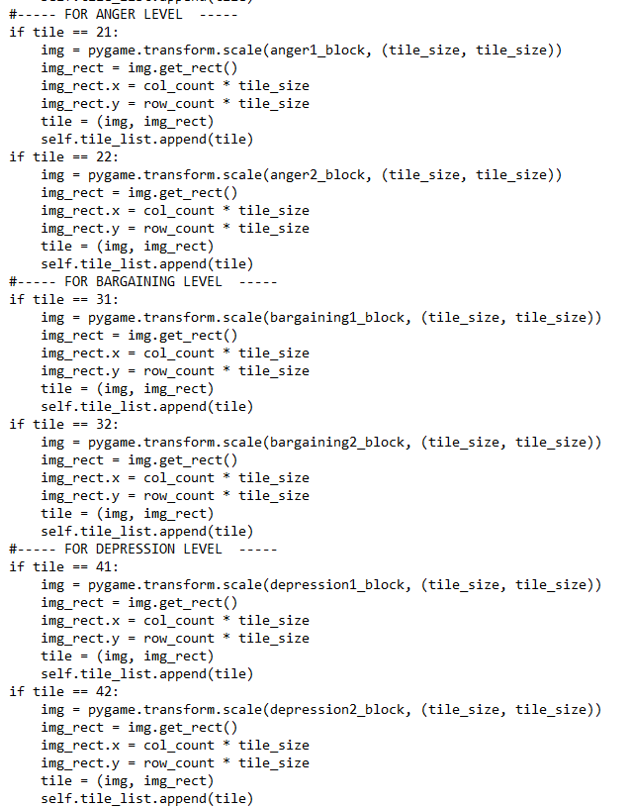
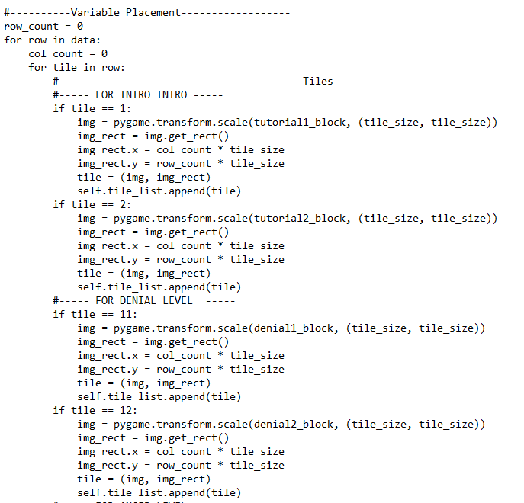
JUMP TO…

Slide 43
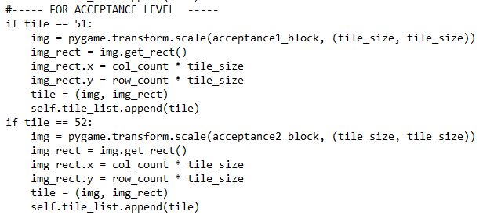
JUMP TO…

Slide 44
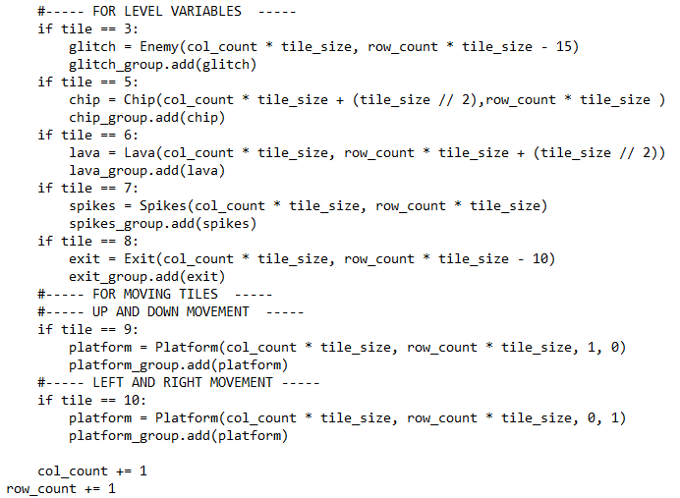
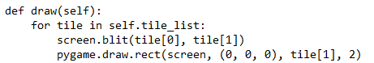
JUMP TO…

Slide 45
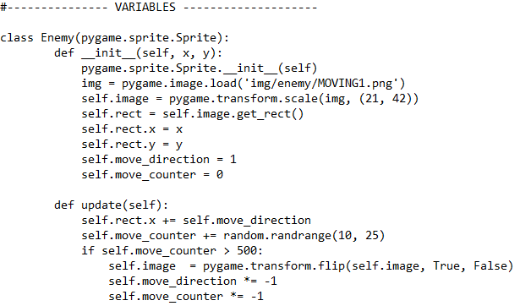
JUMP TO…

Slide 46
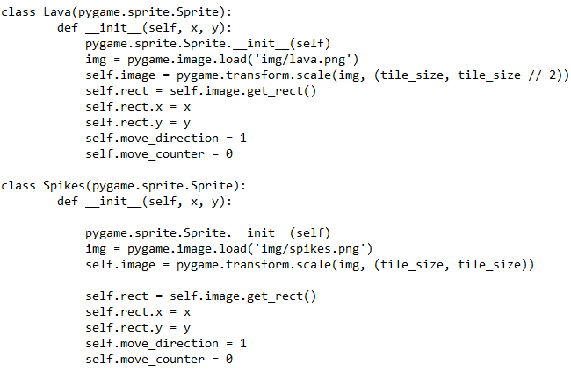
JUMP TO…

Slide 47
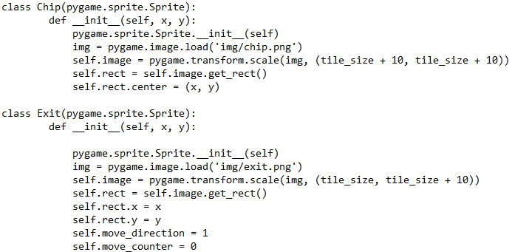
JUMP TO…

Slide 48
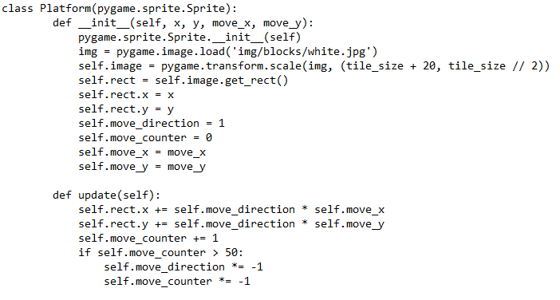
JUMP TO…

Slide 49
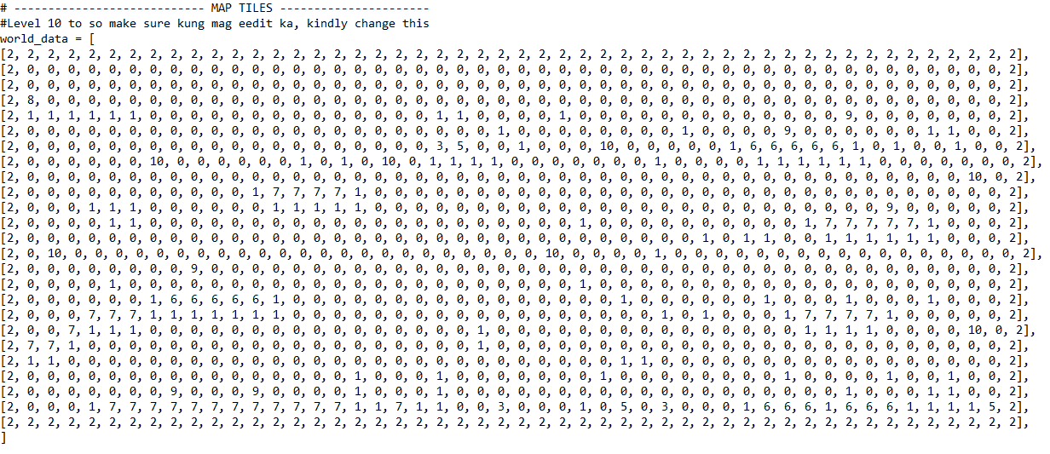
JUMP TO…

Slide 50
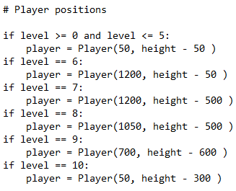
JUMP TO…

Slide 51
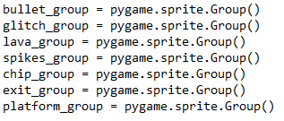
JUMP TO…

Slide 52
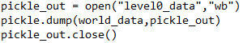
JUMP TO…

Slide 53
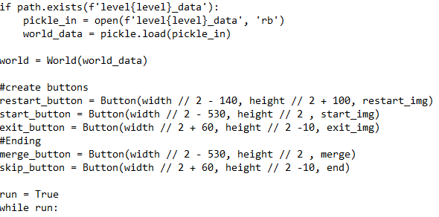
JUMP TO…

Slide 54
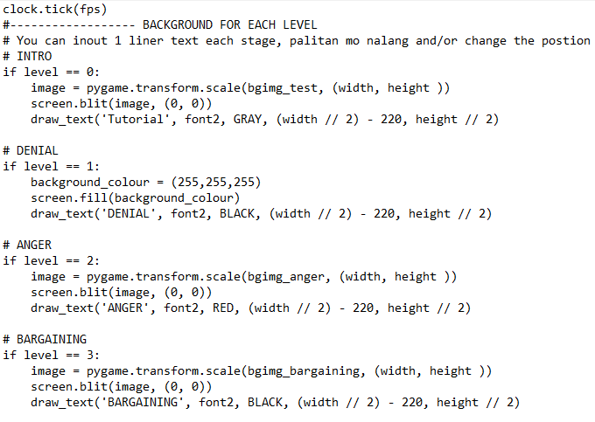
JUMP TO…

Slide 55
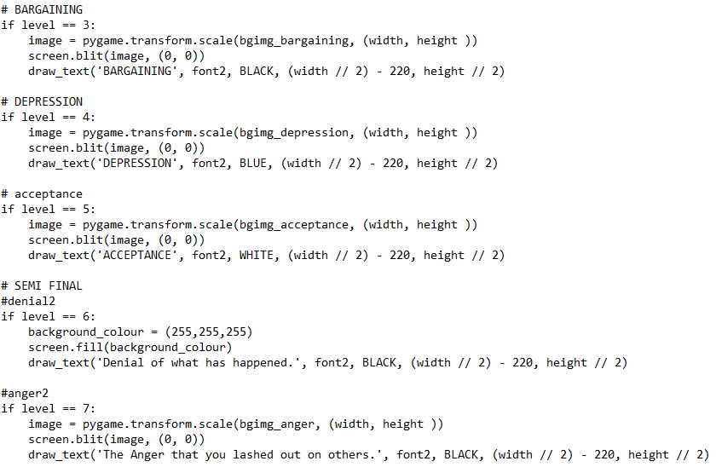
JUMP TO…

Slide 56

JUMP TO…

Slide 57

JUMP TO…

Slide 58

JUMP TO…

Slide 59

JUMP TO…

Slide 60

JUMP TO…

Slide 61

JUMP TO…

Slide 62

JUMP TO…

Slide 63

JUMP TO…

Slide 64

JUMP TO…

Slide 65

JUMP TO…

Slide 66

View code
Run code
JUMP TO…

Slide 67
Documentation
JUMP TO…

Slide 68
JUMP TO…

Slide 69
JUMP TO…

